Slide 1
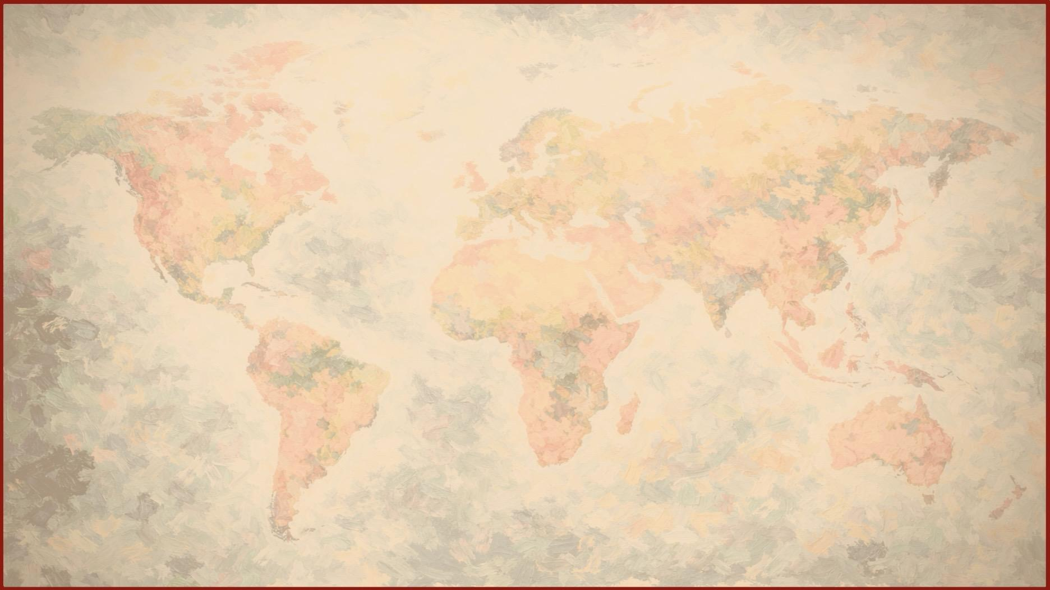
Introduction to Romans
God’s Grace for a Broken World

Slide 2
For in it the righteousness of God is revealed
from faith for faith, as it is written,
“The righteous shall live by faith.”
Romans 1:17

Slide 3
Through faith in Jesus,
anyone can move from condemnation
to a life of global purpose.

Slide 4

A Four-Part Roadmap
We’ll navigate this 16-chapter letter through four movements

Slide 5
Righteousness Only Through Faith (1:1– 4:25)

Slide 6
Righteousness Only Through Faith (1:1– 4:25)
New Life in the Spirit (5:1– 8:39)

Slide 7
Righteousness Only Through Faith (1:1– 4:25)
New Life in the Spirit (5:1– 8:39)
God’s Grace in His Mission (9:1–11:36)

Slide 8

Righteousness Only Through Faith (1:1– 4:25)
New Life in the Spirit (5:1– 8:39)
God’s Grace in His Mission (9:1–11:36)
Our Christian Obligations (12:1–16:27)

Slide 9

Romans is the epicenter of the Bible
It’s where the ancient promises of God
find fulfillment in the world today, in all its brokenness.
The book of Romans is the royal announcement
that the death and resurrection of Jesus have fulfilled history (1:1-4)
and opened a door of hope to all people.
The Gospel of God

Slide 10
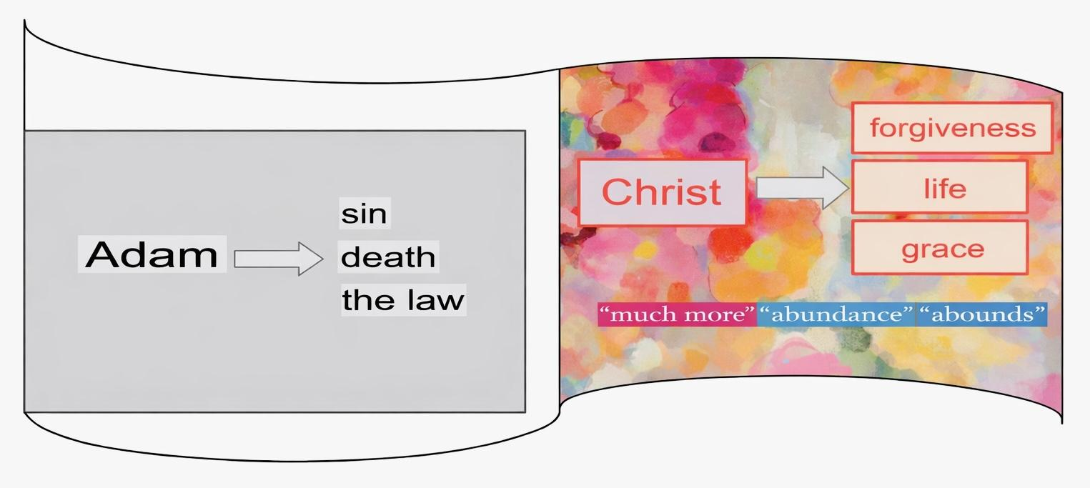
God’s salvation plan fulfilled
Romans 5:12-21
Sin reigned in death through Adam
Grace reigns,
leading to eternal life in Jesus Christ our Lord

Slide 11
Context and Purpose
Author: Apostle Paul, written in AD 57
Audience and purpose: To house churches in Rome;
to explain, defend and promote the gospel of Jesus and have a harvest among them (1:13–15)
Conflict: Paul seeks to unite the “weak” (Jewish) and “strong” (Gentile) under our Lord so they can glorify God, be filled with hope, and together, reach the world (14:1–15:13)

Slide 12
How we’ll study Romans

Slide 13
Each week we’ll use the
Inductive Bible Study Method
Observe Interpret Apply

Slide 14

Observe
read text carefully
find repeated words
and phrases
find contrasts and comparisons
look for Paul’s logic
try to memorize the passage

Slide 15

Interpret
look up word meanings
look for the context
and theme
look for the main idea
and why Paul is
communicating it

Slide 16
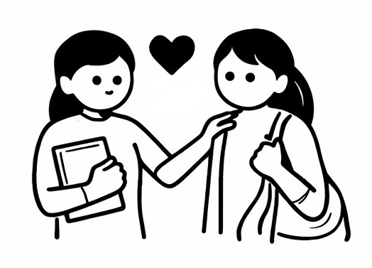
Apply
apply what we learn
to our own lives—
at home, church,
schools/campuses, work; in our communities
and the world

Slide 17


In each step we need the Holy Spirit’s help.
We can’t understand or live the truths of Romans
apart from the Spirit of life.
Each week we will ask Him to intercede for us and lead our study.

Slide 18
Style and Repeated Words & Ideas

Slide 19
Style
Romans is a missionary manifesto
written dialectically (as if Paul’s engaged in a debate)
opposing questions and answers are used
  to anticipate misunderstandings
  engage his audience
  lead the discussion
Paul uses comparisons, logic and repetition,
to help in understanding

Slide 20
Key Themes
The Divine Initiative
The Authority of Scripture – over 60 OT quotes
“The Gospel” – 12 times
“His Grace” – 24 times
“His Mercy” – 12 times

Slide 21
Key Themes
The Character of the Godhead
The Father (the Source) – 178 times
The Son (Savior, King and Lord) – 56 times
The Spirit (the Power and Person) – 29 times

Slide 22
Key Themes
Righteousness Through Faith (The Ultimate Theme)
God’s Righteousness
“righteousness” or “justify” – 60 times
“God’s Righteousness” – 8 times
“Faith” – 61 times
Obedience – “the obedience of faith” – 6 times

Slide 23

“the obedience of faith”
Many think, “believe in Jesus and do as you please”
But Romans begins and ends
with “the obedience of faith”
Romans 1:5 Romans 16:26
Only “the obedience of faith” in Christ brings true freedom,
because it “leads” to “the fruit” of “sanctification” and “eternal life”

Slide 24
“the obedience of faith” cont’d
it is not just doing the bare minimum but obedience “from the heart” (6:17)
to our Lord Jesus, who truly loves us
it’s not to earn justification, but evidence of true faith in his grace
it’s “obedience…for the sake of his name among all the nations” (1:5)
from
the heart
faith in his grace
for the sake of his name

Slide 25
Key Themes
A Shared Vision for the World
God’s hope for all
“gentiles” – 22 times
“nations” – 4 times
“also the Greek” – 3 times
“the world” – 7 times
The Missionary Call
Paul asks, “How then will they call on him in whom they have not believed?” (10:14–15). We need to hear this missionary call personally, and send or be sent to share the good news of the gospel.

Slide 26
Key Themes
A Shared Vision for the World cont’d
Supporting the Mission Field and Reaching the Lost Paul shares his heart to reach the lost and asks
the Roman church to pray for him. (15:20–21,30)
Let's pray to support and send missionaries with this shared vision.
A Diverse Church
As we learn to truly “welcome one another as Christ has welcomed you” (15:7), we glorify God and legitimize our prayers to reach people of all the nations.

Slide 27
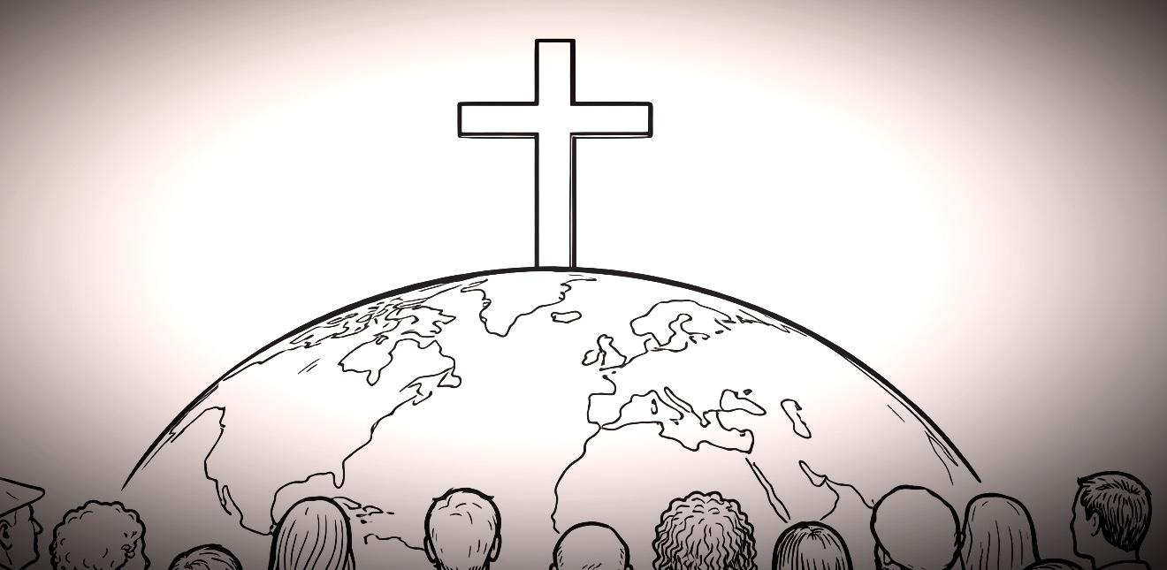
Let’s ask God to help us truly receive
the “righteousness of God” by faith (1:17), and prepare to be sent and to send
because of His amazing grace.

